Slide 1

Artificial Intelligence and Financial Translation
Sai-cheong SIU
Associate Professor
Programme Director, Master of Arts in Translation (Computer (-Aided) Translation)
The Hang Seng University of Hong Kong

Slide 2
Artificial intelligence (AI) is everywhere!
Chatbots: Facilitating human-like digital conversations
Generative AI: Creating new content, including images and music
Game-playing AI: Mastering and competing in complex games
Image Recognition: Classifying and categorizing images
Object Detection: Recognizing specific items within images
Trend Analysis and Prediction: Predicting future trends, such as stock prices and weather patterns
Robotic Control: Directing robotic operations with AI

Slide 3

AI can also enhance translation technology and professional translation.

Slide 4
I focus on AI-assisted specialized translation.
Offering Translation Technology/CAT courses for undergraduate and postgraduate students
Conducting research projects for innovative tool development

Slide 5

Key areas of our work
Government Translation
Scientific Translation
Legal Translation
Buddhist Text Translation
Medical Translation
Digital Entertainment Translation
Journalistic Translation
Financial Translation

Slide 6
Focus of this talk
AI developments
Highlighting the latest advancements
Innovative tools developed by us
Exploring how these developments could lead to potential new tools for financial translators, reshaping global financial communication

Slide 7
Outline
1. Financial Translation in Hong Kong: Significance, challenges and opportunities
2. Recent AI Advancements: Key developments and breakthroughs
3. AI Applications for Financial Translators: Our work as examples
4. The Way Forward: A few noteworthy directions

Slide 8

1. Financial Translation in Hong Kong

Slide 9
Role of financial translation in HK’s economy
Financial translation is integral to multiple sectors in HK’s vibrant economy.
Banking
Investment management
Insurance
Real estate
Accounting and auditing
Legal services

Slide 10

Significance of financial translation in HK
Enhanced Communication
Facilitates cross-language interactions among investors, clients, and stakeholders
Transparency
Ensures accurate understanding of financial reports and contracts, fostering informed investment and trust in international transactions
Legal Compliance
Aids in maintaining compliance with local and international financial laws, reducing legal risk
Global Market Reach
Enables effective engagement with international clients, increasing potential for foreign investment

Slide 11
Key financial documents
1. Regulatory Documents
Mandatory filings for regulatory bodies (e.g., IPO prospectuses)
2. Company Annual Reports
Detailed annual overviews of company’s performance and activities
3. Corporate Announcements and Circulars
Important updates and news for stakeholders (e.g., major corporate decisions)
4. Market Insights & Financial News
Investment analyses and financial news articles
5. Financial Product Marketing Materials
Promotional content for financial products (e.g., product brochures, newsletters, websites)
6. Legal and Contractual Documents
Legal agreements, contracts, terms and conditions, and disclaimers in financial operations

Slide 12
Challenges of financial translation
Terminology
Ensuring accurate translation of industry jargon
Domain Knowledge
Mastering diverse financial domains
Compliance & Accuracy
Familiarizing with regulations to ensure precision
Confidentiality
Protecting sensitive information
Time Constraints
Managing speed and accuracy
Dynamic Source Text
Translating updated or non-finalized text while maintaining format

Slide 13
Opportunities for financial translation in HK
Fintech
Regulatory Changes
Sustainable Finance
Cross-Border Initiatives
Emerging services such as virtual banks, cryptocurrencies, and P2P lending
ESG reporting, weighted voting rights, and pre-revenue biotech listings
Growing green bonds and eco-friendly market
Stock Connect, Cross-boundary Wealth Management Connect Scheme, and Hong Kong's offshore RMB hub role
Emerging trends in Hong Kong’s financial sector present translation opportunities:

Slide 14
Current tools for financial translators
Specialized dictionaries
Electronic databases
Machine translation
Document comparison tools
Translation memories
Terminology databases
Quality assurance tools

Slide 15

2. Recent AI Advancements

Slide 16
Three concepts
Artificial Intelligence
Machine Learning
Deep Learning
Notes:
More specifically there are three related concepts I need to explain here
In addition to AI, when we discuss technology
we sometimes also use machine learning and deep learning

Slide 17




Example
a cat
or a dog?
AI
Machine Learning
1. Rules
2. Data
Deep Learning
Different Methods

Slide 18

Artificial Intelligence
Machine Learning
Symbolic AI
Deep Learning
Other Methods

Slide 19
Deep learning
Read more Siu (2023b).

Slide 20
Features of deep learning
3. Versatility across domains
1. Multilayered artificial neurons
2. Feature extraction and representation
4. Resurgence in popularity

Slide 21


Feature 1: Multilayered artificial neurons
A cat or a dog?
Raw input of image
Network with multiple layers of neurons
More meaningful
representation

Slide 22
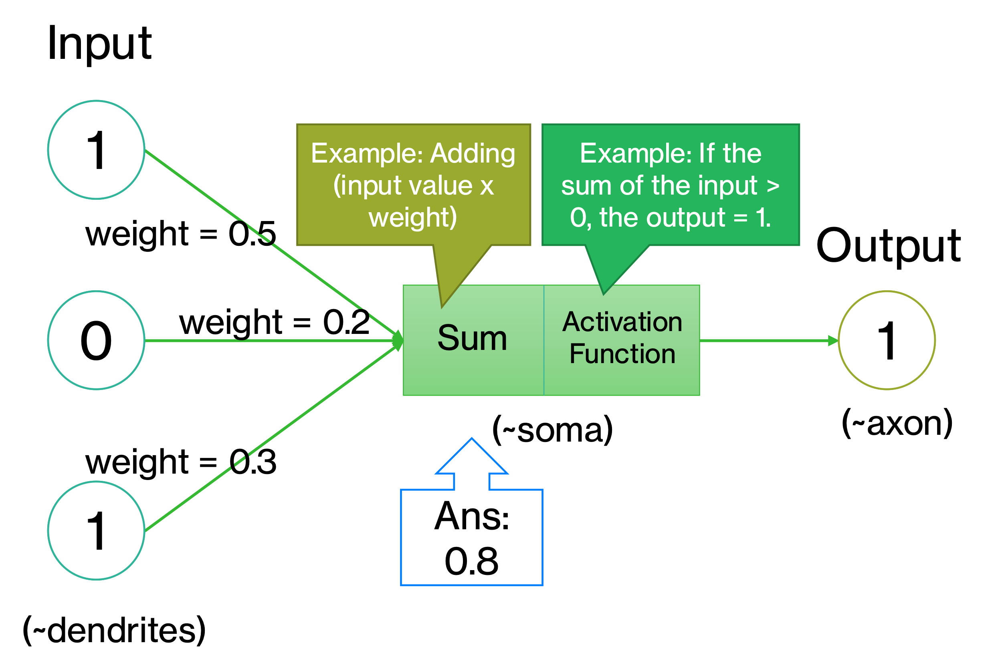
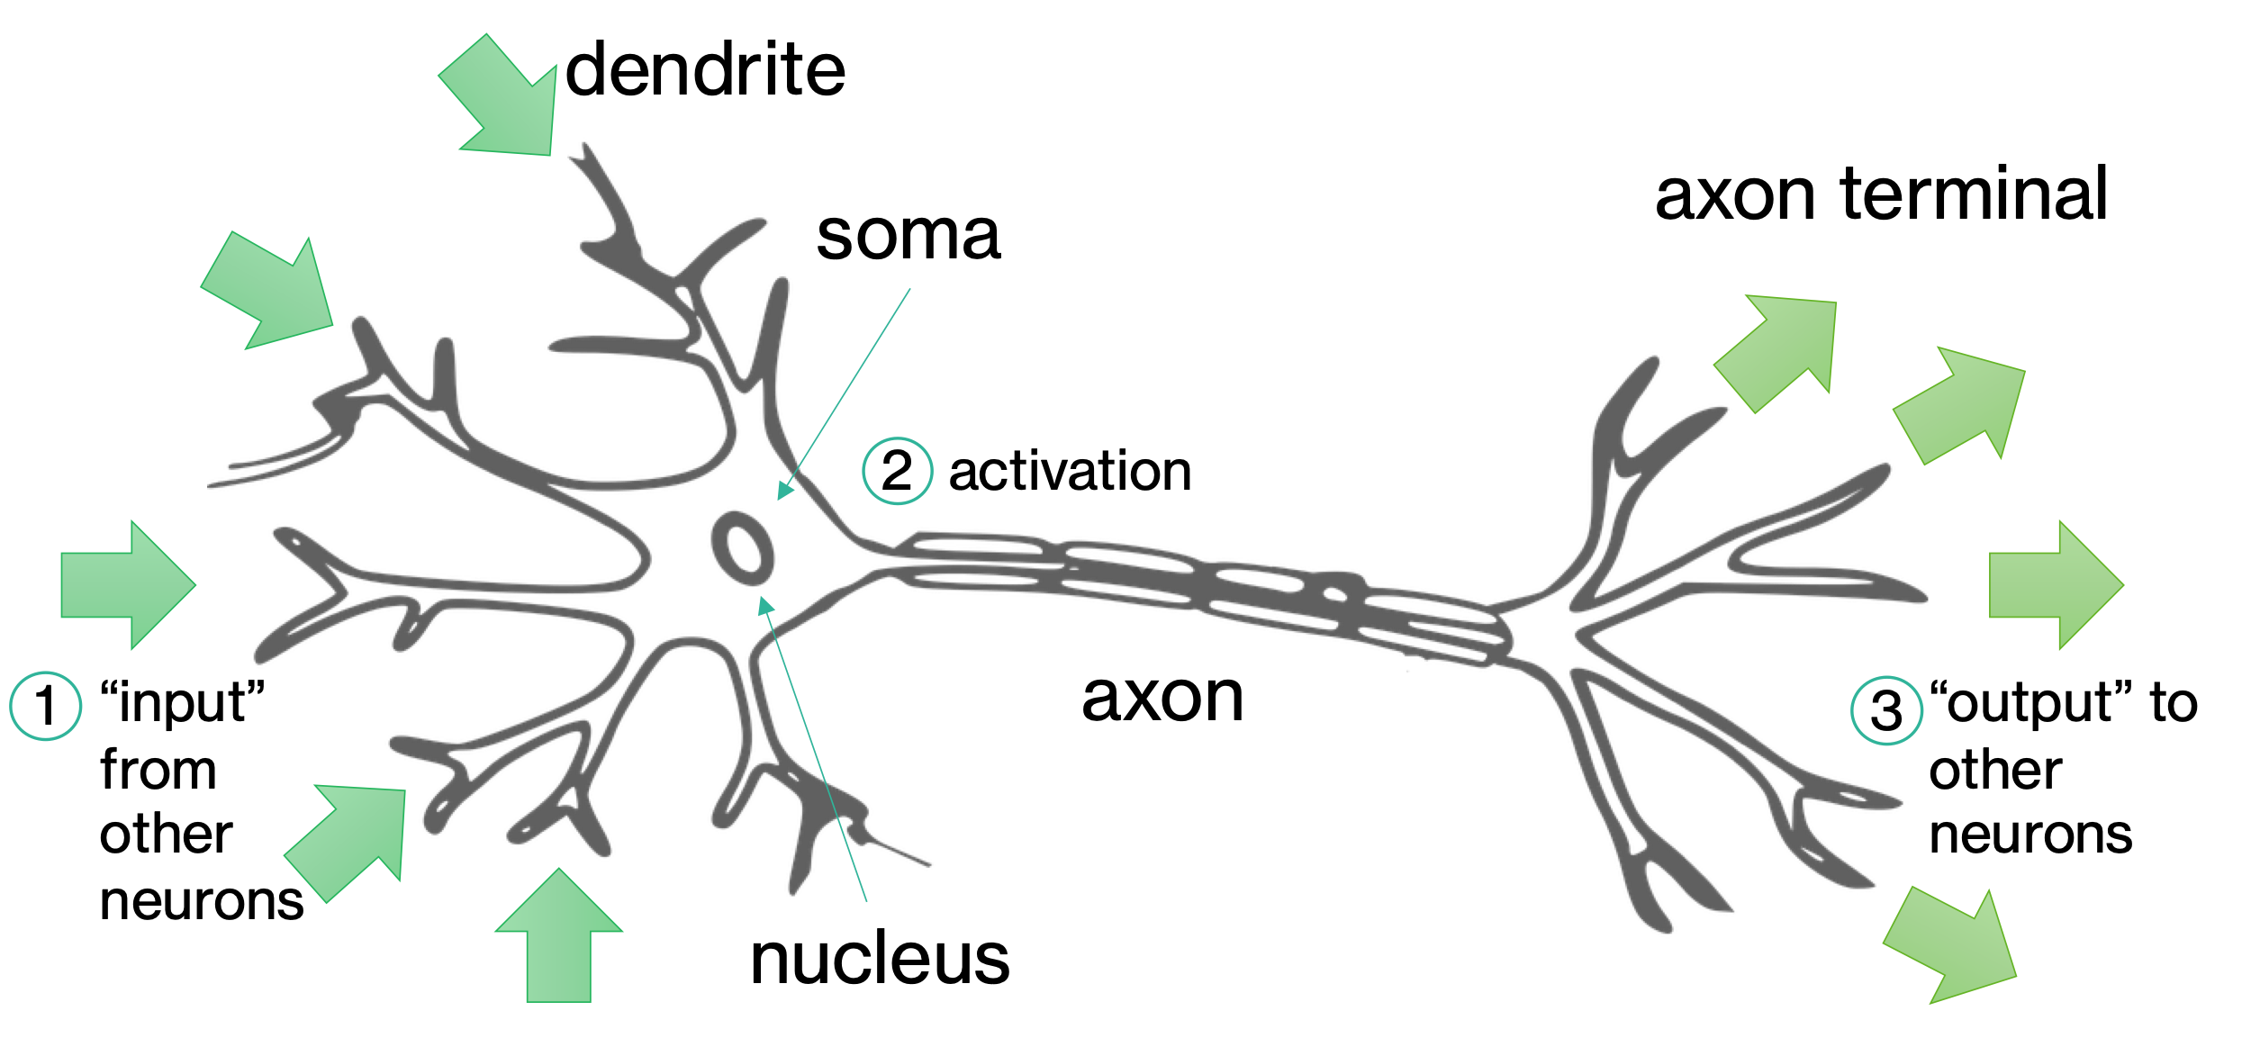
Biological Neuron
Artificial Neuron
We can modify a neuron's behavior by adjusting its weights (loosely equivalent to how biological neurons are connected). This weight adjustment is crucial to the model's training process.

Slide 23
Artificial Neural Network

Slide 24
Input
Hidden
Output
Deep Neural Network

Slide 25







Feature 2: Feature extraction and representation
Features:
shape, size, or color of the ears, nose, or tail?
Data-driven methods
“Map” provided by developer
general methods
both require
but …
it’s like…
training data
Self-discovery of features
deep learning
“Map” created by model

Slide 26



Feature 3: Versatility across domains
Image recognition
A cat or a dog?
Trend prediction
Sentiment
analysis
Positive or negative
Text generation / translation

Slide 27
Feature 4: Resurgence in popularity
Data
Hardware
Deep learning algorithms
Programming tools

Slide 28








Key Concepts
1. Key Components
2. Key Tasks
1. Data Collection
2. Model Design
Training
Validation
Test
Neuron?
Connection?
Data
Network
3. Model Training
4. Model Evaluation
Forward propagation
Loss calculation
Backpropagation
Optimization
Algorithm

Slide 29

A cat or a dog?
Actual outcomes:
Correct answers
Loss / Cost
Dog Dog Cat Cat
Difference
Adjust
Cat? Dog? Cat? Dog?
Training data
Initial model:
Randomly initialized parameters
Model predictions:
Wild guesses
Model being trained /
Trained model
Predictions
VS Actual outcomes
Validation data /
Testing data

Slide 30




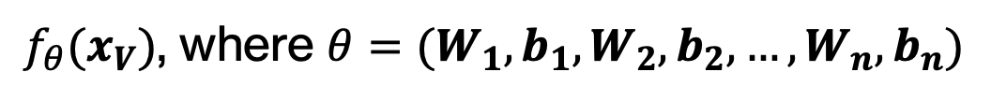
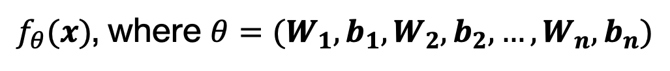
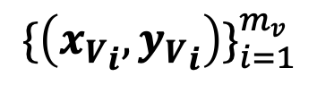
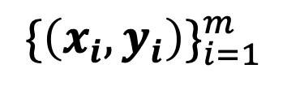
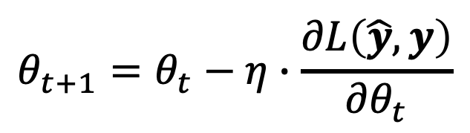
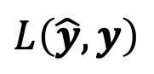
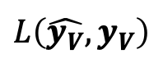
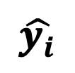
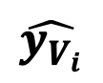
Formally, we have the following:
$${\{\left(x_{i},y_{i}\right)\}}_{i=1}^{m}$$
$$\hat{y_{i}}$$
$$L\left(\hat{y},y\right)$$
$f_{θ}(x)$, where $θ=(W_{1},b_{1},W_{2},b_{2},…,W_{n},b_{n})$
Training
$$θ_{t+1}=θ_{t}−η∙\frac{∂L\left(\hat{y},y\right)}{{∂θ}_{t}}$$
$${\{\left({x_{V}}_{i},{y_{V}}_{i}\right)\}}_{i=1}^{m_{v}}$$
$f_{θ}(x_{V})$, where $θ=(W_{1},b_{1},W_{2},b_{2},…,W_{n},b_{n})$
$$\hat{y_{V_{i}}}$$
$$L\left(\hat{y_{V}},y_{V}\right)$$
Validation

Slide 31
In the context of translation, a key example is …
Neural machine translation (NMT)

Slide 32
Conventional methods
I go to school by train.
I go to school by taxi. 我坐計程車去學校。
我坐火車去學校。
Translation Model
P(“I”|“我”) x P(“go”|“去”) x ...
Language Model
P(“我坐火車去學校”)
I go to school by train.
我／去／學校／坐／火車／。
我坐火車去學校。
Rule-based Machine Translation
Example-based Machine Translation
Statistical Machine Translation

Slide 33
Example of NMT
Encoder
ST
Example: I love translation.
Next TT word?
TT
Decoder
Example: 我

Slide 34
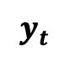
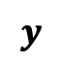


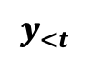

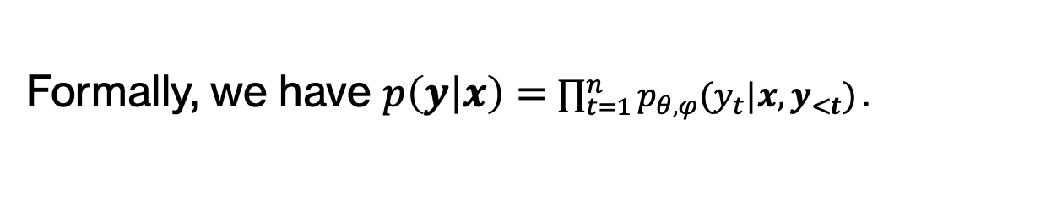
Auto-regressive NMT with encoder and decoder
$$x$$
$$θ$$
ST
Encoder
Internal representation (ST)
$$y_{<t}$$
$$φ$$
$$y_{t}$$
TT so far
Decoder
Internal representation (TT)
Next TT token
$$y$$
Formally, we have $p\left(y | x\right)=$ $\prod_{t=1}^{n}{p_{θ,φ}(y_{t}|x,y_{<t})}.$
TT

Slide 35
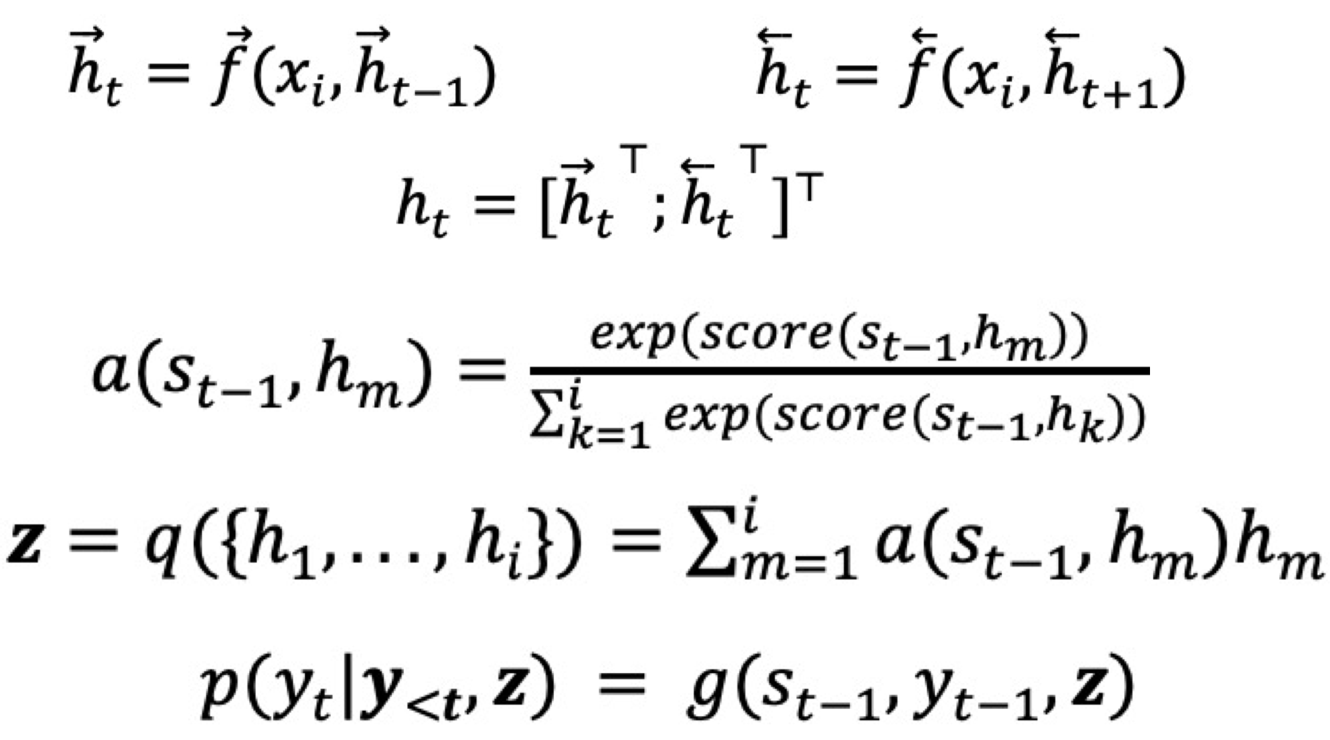
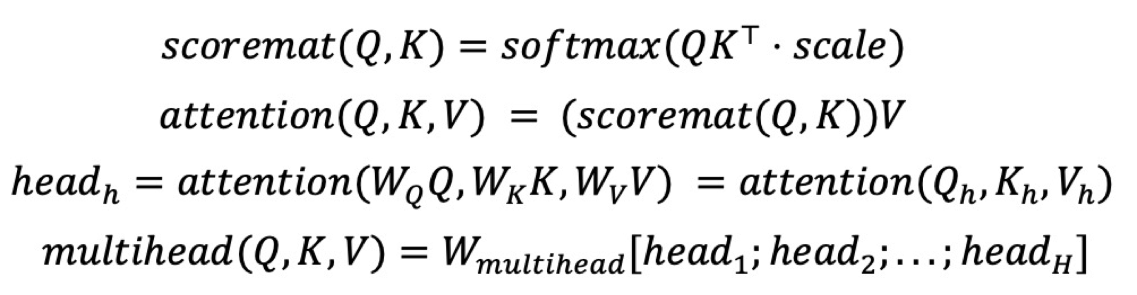
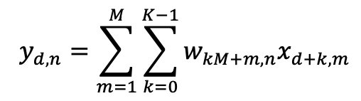
Common types of networks
ChatGPT
1. Recurrent Neural Networks (RNN)
2. Convolutional Neural Networks (CNN)
3. Self-attention Neural Networks (e.g., Transformer)
Bidirectional RNN with Attention
One-dimensional convolutional layer
Multi-head Attention with Queries, Keys and Values
Example:
Example:
Example:

Slide 36

3. AI-driven Applications for Financial Translators

Slide 37
Driving innovation in translation technology with AI: Examples
Platform 1: Term extractor
Platform 3: Text explainer
Platform 2: IPOTranslate
Platform 4: Sentence finder

Slide 38

Platform 1: Term Extractor
Objective: Our primary goal is to accurately and efficiently extract relevant terms from bilingual documents, thereby achieving AI-assisted term extraction and termbase building.
Translation Enhancement: Our system aims to enhance overall translation quality by improving the consistency, accuracy, and efficiency of term translation.

Slide 39

Conventional methods
Linguistic methods
Term Length: Define minimum and maximum length of terms, typically in number of words (e.g., 1-4 words)
Frequency and Statistical Thresholds: Set a minimum occurrence count for a term to be considered relevant (e.g., at least 5 times) and establish thresholds for statistical measures like TF-IDF (e.g., TF-IDF score above a specific threshold)
Part-of-Speech Patterns: Specify patterns for linguistic methods (e.g., looking for noun phrases or verb phrases)
Dictionary or Stopword List: Provide a list of known terms to seek or common words to ignore
Grammar and syntax rules; POS tagging
Statistical methods
Term frequency and document frequency

Slide 40
Current challenges (1)
Term Length
Some relevant terms or phrases may exceed the user-specified length.
Frequency-Based Limitations
Less frequent but highly relevant terms may be overlooked, while common but irrelevant words may be incorrectly identified.
Overlapping Terms
Extraction may result in overlapping terms, requiring manual filtering (e.g., "heart", "heart disease", and "coronary heart disease").

Slide 41
Current challenges (2)
Linguistic Rules Complexity
Constructing comprehensive and accurate linguistic rules can be challenging due to the complexity of natural language.
Statistical Method Limitations
These methods may struggle with words that have multiple meanings, rare words, and may also require substantial computational resources.
Bi-Text Size
If the text is too short, the accuracy of term extraction may be compromised.

Slide 42
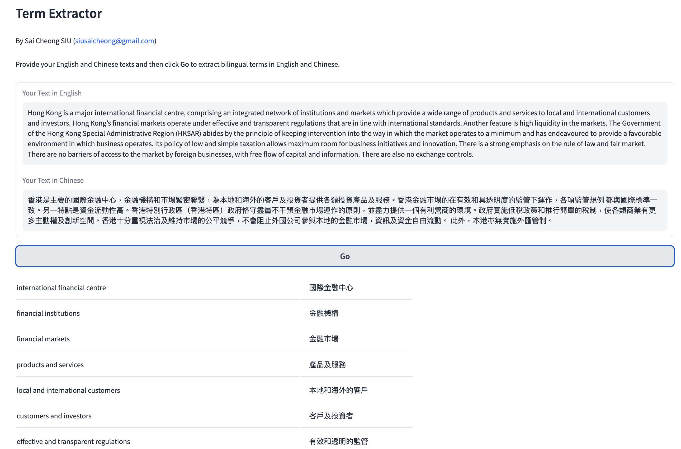

Slide 43


How does it work?
Bilingual documents
Extraction
Bilingual terms
Enhancement
Refined bilingual terms

Slide 44
Example
Hong Kong is a major international financial centre, comprising an integrated network of institutions and markets which provide a wide range of products and services to local and international customers and investors. Hong Kong’s financial markets operate under effective and transparent regulations that are in line with international standards. Another feature is high liquidity in the markets. The Government of the Hong Kong Special Administrative Region (HKSAR) abides by the principle of keeping intervention into the way in which the market operates to a minimum and has endeavoured to provide a favourable environment in which business operates. Its policy of low and simple taxation allows maximum room for business initiatives and innovation. There is a strong emphasis on the rule of law and fair market. There are no barriers of access to the market by foreign businesses, with free flow of capital and information. There are also no exchange controls.
香港是主要的國際金融中心，金融機構和市場緊密聯繫，為本地和海外的客戶及投資者提供各類投資產品及服務。香港金融市場的在有效和具透明度的監管下運作，各項監管規例 都與國際標準一致。另一特點是資金流動性高。香港特別行政區（香港特區）政府恪守盡量不干預金融市場運作的原則，並盡力提供一個有利營商的環境。政府實施低稅政策和推行簡單的稅制，使各類商業有更多主動權及創新空間。香港十分重視法治及維持巿場的公平競爭，不會阻止外國公司參與本地的金融市場，資訊及資金自由流動。 此外，本港亦無實施外匯管制。

Slide 45
An online tool
English | Chinese
Hong Kong | 香港
high liquidity | 資金流動性
business | 營商
foreign businesses | 外國公司參與本地
free flow | 自由流動
products | 產品
financial markets | 金融市
markets | 市場
the principle | 原則
Hong Kong’s | 香港金融市場
simple taxation | 簡單的稅制
business initiatives | 商業
institutions | 機構
Configurations: Min. frequency: 1; length range: 1-8

Slide 46
Our tool
international financial centre | 國際金融中心
financial institutions | 金融機構
financial markets | 金融市場
products and services | 產品及服務
local and international customers | 本地和海外的客戶
customers and investors | 客戶及投資者
effective and transparent regulations | 有效和透明的監管
international standards | 國際標準
high liquidity | 資金流動性高
Government of the Hong Kong Special Administrative Region | 香港特別行政區政府
principle of keeping intervention into the way in which the market operates to a minimum | 盡量不干預金融市場運作的原則
policy of low and simple taxation | 低稅政策
maximum room for business initiatives and innovation | 更多主動權及創新空間
rule of law | 法治
fair market | 公平競爭
free flow of capital and information | 資訊及資金自由流動
exchange controls | 外匯管制
17 terms were extracted.
No extra configuration is required from the user's side.
More accurate and useful expressions of varying lengths were extracted

Slide 47
Platform 2: IPOTranslate
“Machine Translation of IPO Documents”
The work described here was fully supported by the Innovation Technology Fund (ITF/238/17).

Slide 48

The need for bilingual IPO prospectuses
An IPO prospectus is a comprehensive document that outlines the details of a company's financial health, operations, and plans.
In Hong Kong, an IPO prospectus must be available in both English and Chinese to cater to the diverse investor base and comply with regulatory requirements.
This has led to a high demand for professional translation services to ensure accurate and timely translations.

Slide 49
Limitations of current MT systems
Machine translation systems may provide a solution, but many of them are designed for the translation of general documents rather than listing documents.
The terms and writing style in automatic translation results often do not conform to those adopted in IPO prospectuses, requiring substantial editing.

Slide 50

Our solution: IPOTranslate
We propose a specialized NMT system designed for the translation of IPO prospectuses, with the following two features:
Feature 1: Domain-specific engines trained on both general and specialized documents.
Feature 2: Dual-engine output based on two models with different network architectures, providing alternative translations for reference.

Slide 51
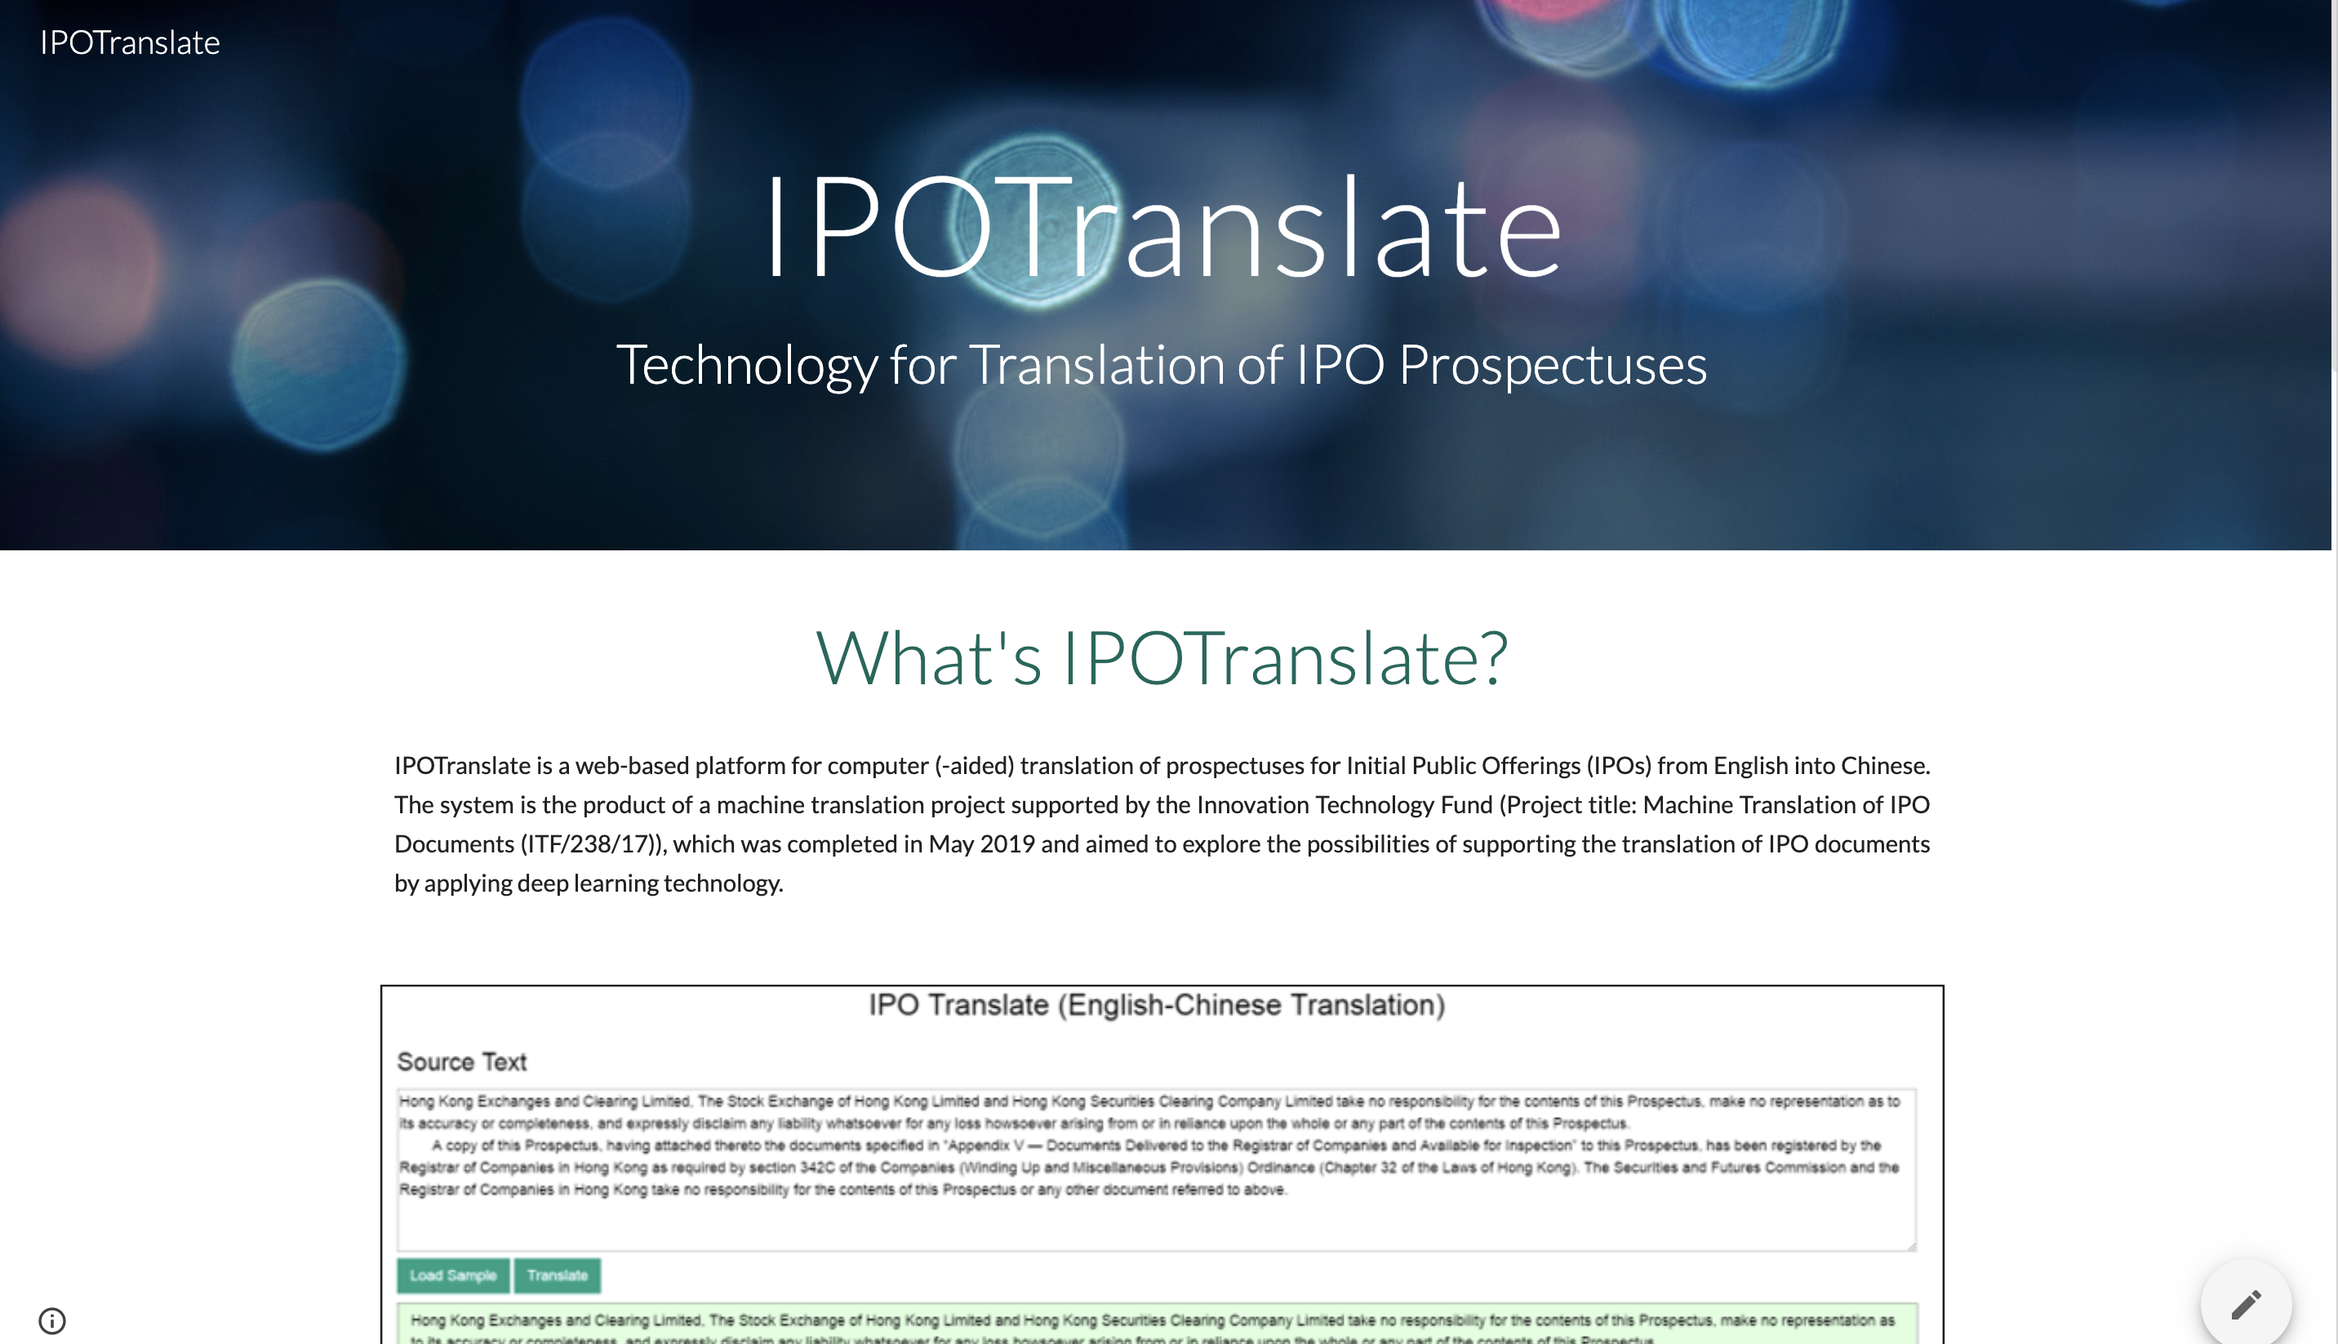

Slide 52
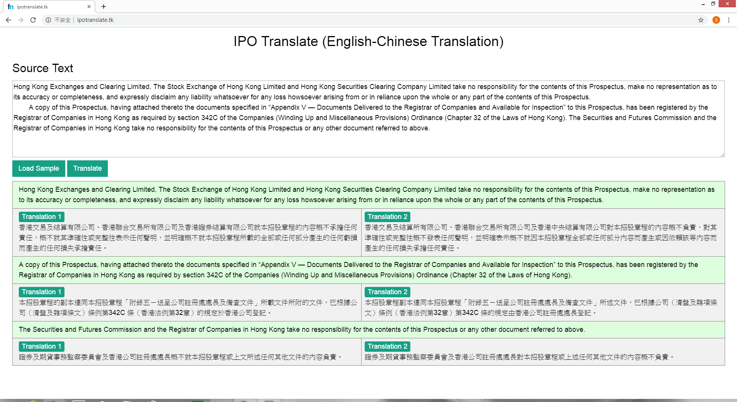

Slide 53
IPOTranslate: How does it work
Specialized encoder 1
Specialized encoder 2
ST
ST
Specialized decoder 1
Specialized decoder 2
TL words generated so far
TL words generated so far
Translation 1
Translation 2

Slide 54
Common types of networks
ChatGPT
1. Recurrent Neural Networks (RNN)
2. Convolutional Neural Networks (CNN)
3. Self-attention Neural Networks (e.g., Transformer)
Bidirectional RNN with Attention
One-dimensional convolutional layer
Multi-head Attention with Queries, Keys and Values
Example:
Example:
Example:

Slide 55
Example 1
Source Text
You should rely only on the information contained in this prospectus and the related Application Forms to make your investment decision.
Human Translation
閣下應僅依賴本招股章程及相關申請表格所載的資料作出投資決定。

Slide 56
Example 1
A famous online MT engine
您應僅依賴本招股說明書中包含的信息和相關的申請表來做出您的投資決定。
Our Translations
閣下僅應依賴本招股章程及相關申請表格所載資料作出投資決定。
閣下應僅依賴本招股章程及相關申請表格所載資料作出投資決定。

Slide 57
Example 2
Source Text
Hong Kong Exchanges and Clearing Limited, The Stock Exchange of Hong Kong Limited and Hong Kong Securities Clearing Company Limited take no responsibility for the contents of this prospectus, make no representation as to its accuracy or completeness and expressly disclaim any liability whatsoever for any loss howsoever arising from or in reliance upon the whole or any part of the contents of this prospectus.

Slide 58
Human Translation
香港交易及結算所有限公司、香港聯合交易所有限公司及香港中央結算有限公司對本招股章程的內容概不負責，對其準確性或完整性亦不發表任何聲明，並明確表示概不會就因本招股章程全部或任何部分內容而產生或因依賴該等內容而引致的任何損失承擔任何責任。
A famous online MT engine
香港交易及結算所有限公司，香港聯合交易所有限公司及香港中央結算有限公司對本招股章程的內容概不負責，亦不對其準確性或完整性作出任何陳述，並明確表示不對任何損失承擔任何責任。 因本招股章程的全部或部分內容而產生或依賴該等招股章程的全部或部分內容。
Our Translations
香港交易及結算有限公司、香港聯合交易所有限公司及香港證券結算有限公司就本招股章程的內容概不承擔任何責任，概不就其準確性或完整性作出任何聲明，並明確不會就本招股章程所載的全部或任何部分內容而產生的任何損失產生任何任何責任。閣下應僅依賴本招股章程及相關申請表格所載資料作出投資決定。
香港交易及結算所有限公司、香港聯合交易所有限公司及香港中央結算有限公司對本招股章程的內容概不負責，對其準確性或完整性概不發表任何聲明，並明確表示概不就因本招股章程全部或任何部分內容而產生或因依賴該等內容而產生的任何損失承擔任何責任。

Slide 59
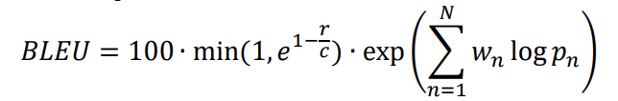
Experiment: results
 | Google | IPOTranslate Model 1 | IPOTranslate Model 2
BLEU Score | 36.89 | 44.48 | 53.73

Slide 60
Platform 3: Text Explainer
This tool helps explain financial text, both in terms of terminology and the overall meaning or ideas within the text.
It complements dictionaries and glossaries.
It is particularly useful when dealing with complex financial documents.

Slide 61


Current challenges
Focus on Words and Short Phrases
They provide limited help to users struggling with understanding larger units, long phrases, and multiple expressions.
Lack of Context-Awareness
For words with multiple meanings, they only provide a list of definitions. Users must manually select the appropriate meaning by going through a long list and considering the context.
First point of reference:
Dictionaries and glossaries

Slide 62
Solution offered by our tool
Contextual Explanation: Our tool provides explanations of expressions with reference to their context, automatically providing the definition most relevant to the context.
Support for Larger Units: Our tool offers support beyond individual words, including explanations of longer phrases and even sentences.

Slide 63
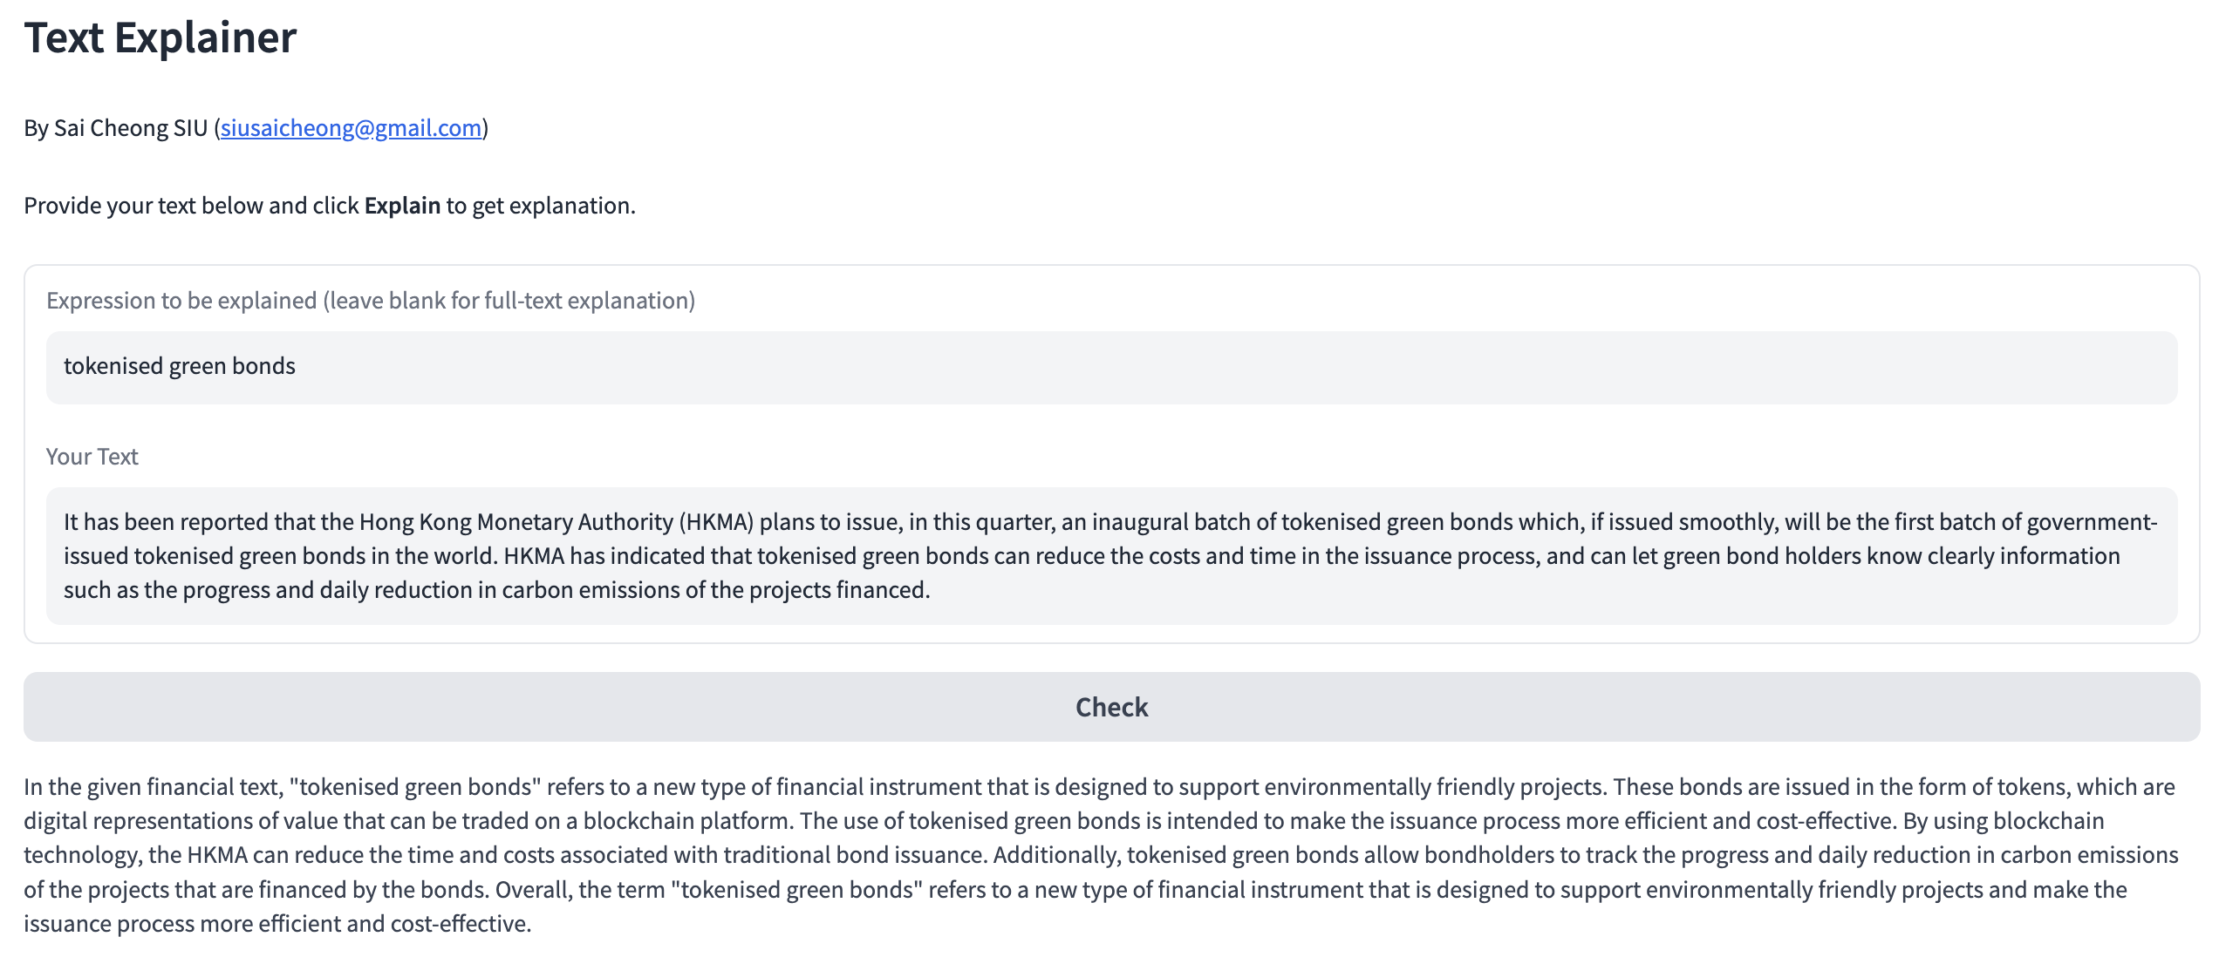
It’s a smart dictionary, featuring (1) context awareness and (2) support for longer expressions

Slide 64
Examples
Example 1: Explaining a common word within a given sentence
Example 2: Explaining a multi-word expression containing a technical term, using a given sentence for context
Example 3: Explaining a given sentence within the context of a paragraph

Slide 65
Example 1
Task: Explain a common word within a given sentence.
Our word here: “sound”

Slide 66
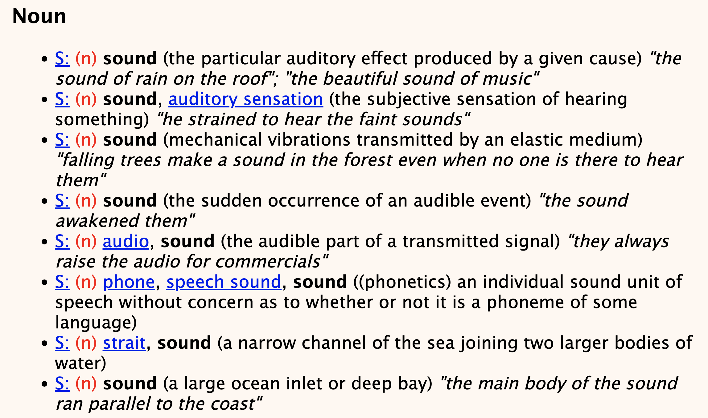
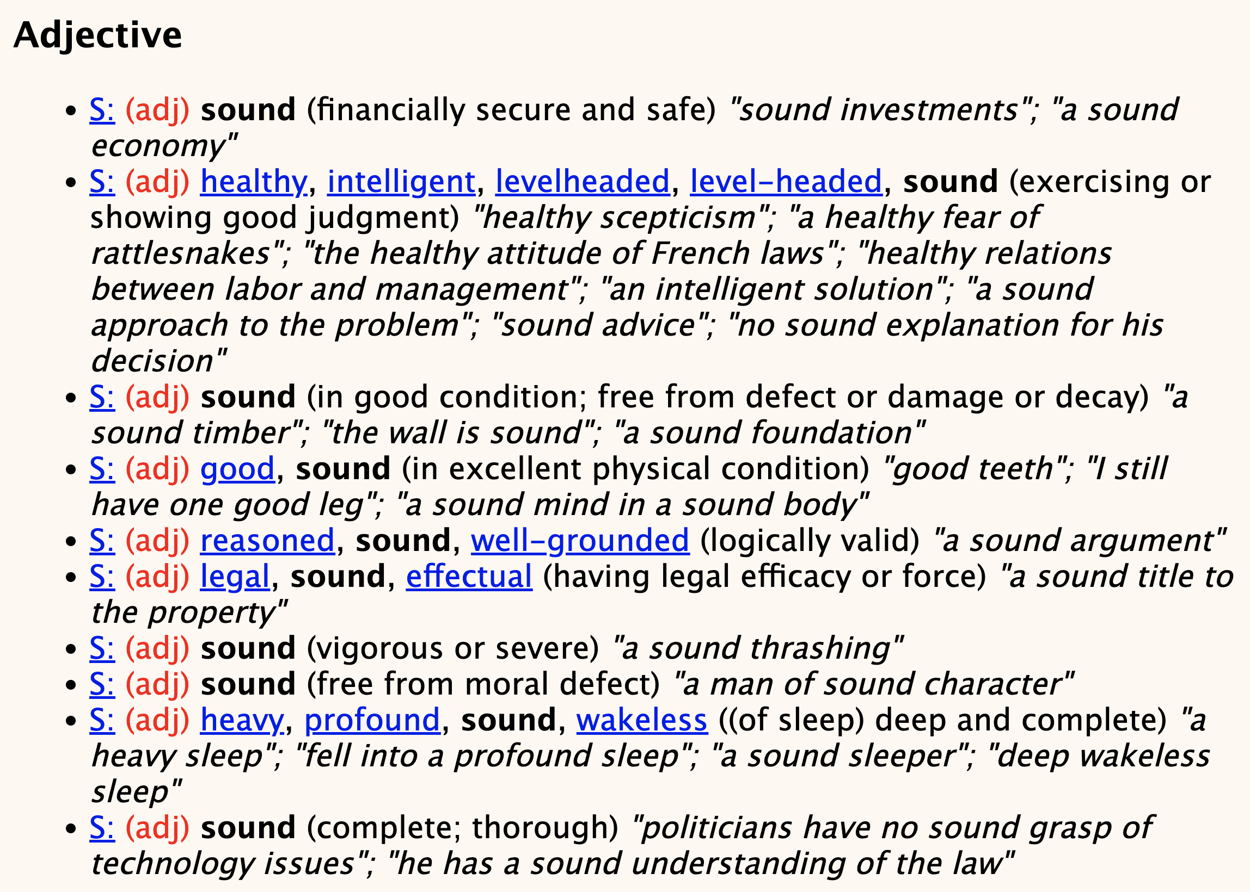
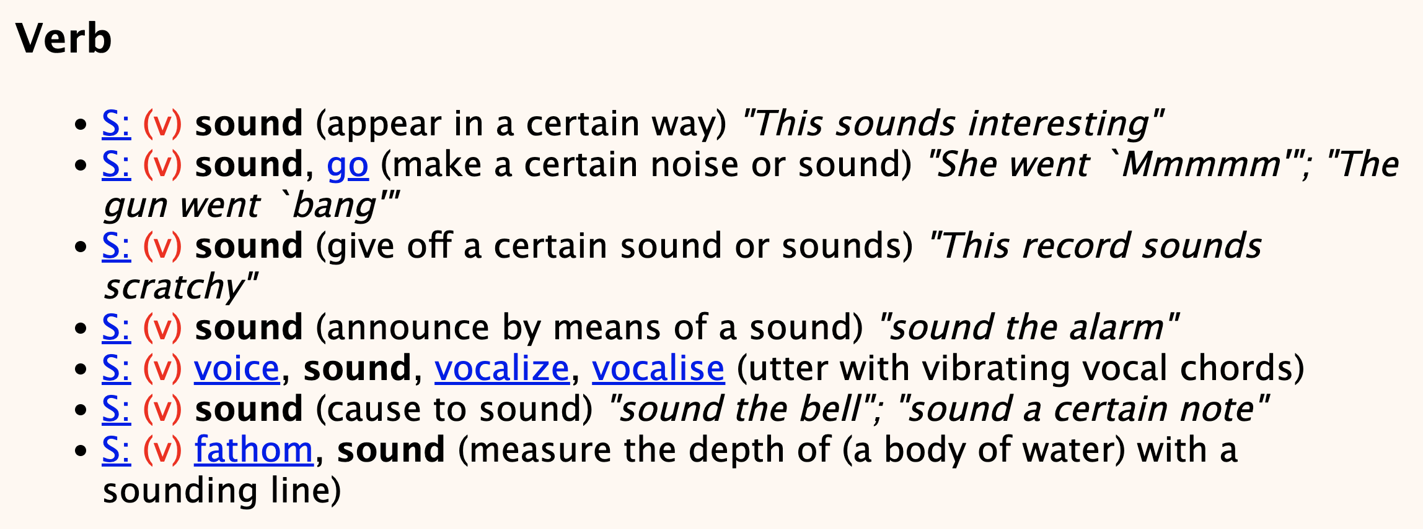
Consider this …
Which one?
Source: WordNet

Slide 67
Now, we have an alternative …

Slide 68
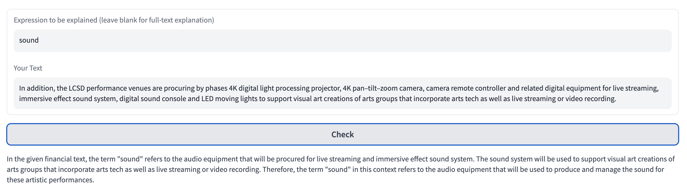
Sound (1)
Context: In addition, the LCSD performance venues are procuring by phases 4K digital light processing projector, 4K pan–tilt–zoom camera, camera remote controller and related digital equipment for live streaming, immersive effect sound system, digital sound console and LED moving lights to support visual art creations of arts groups that incorporate arts tech as well as live streaming or video recording.
Explanation: In the given financial text, the term "sound" refers to the audio equipment that will be procured for live streaming and immersive effect sound system. The sound system will be used to support visual art creations of arts groups that incorporate arts tech as well as live streaming or video recording. Therefore, the term "sound" in this context refers to the audio equipment that will be used to produce and manage the sound for these artistic performances.

Slide 69
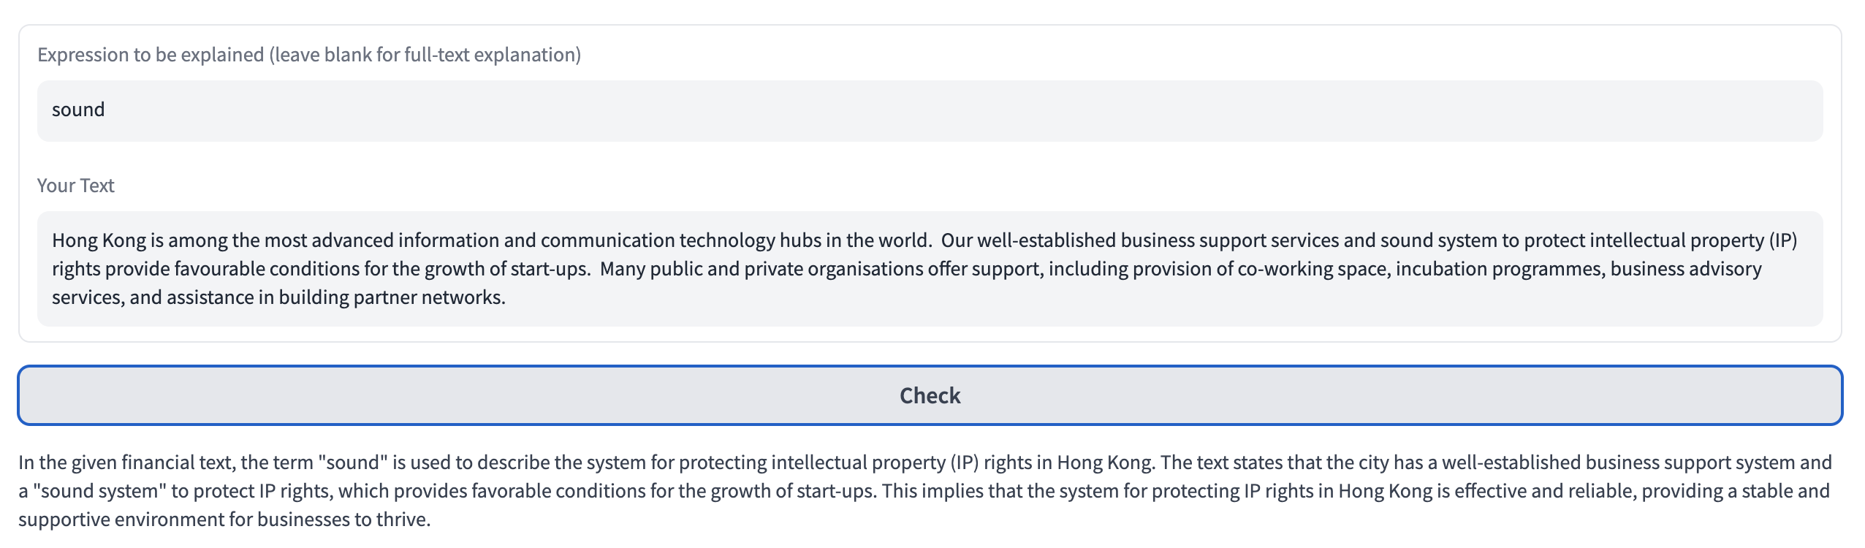
Sound (2)
Context: Hong Kong is among the most advanced information and communication technology hubs in the world. Our well-established business support services and sound system to protect intellectual property (IP) rights provide favourable conditions for the growth of start-ups. Many public and private organisations offer support, including provision of co-working space, incubation programmes, business advisory services, and assistance in building partner networks.
Explanation: In the given financial text, the term "sound" is used to describe the system for protecting intellectual property (IP) rights in Hong Kong. The text states that the city has a well-established business support system and a "sound system" to protect IP rights, which provides favorable conditions for the growth of start-ups. This implies that the system for protecting IP rights in Hong Kong is effective and reliable, providing a stable and supportive environment for businesses to thrive.

Slide 70
Example 2
Task: Explain a multi-word expression containing technical terms, using a given sentence for context.

Slide 71
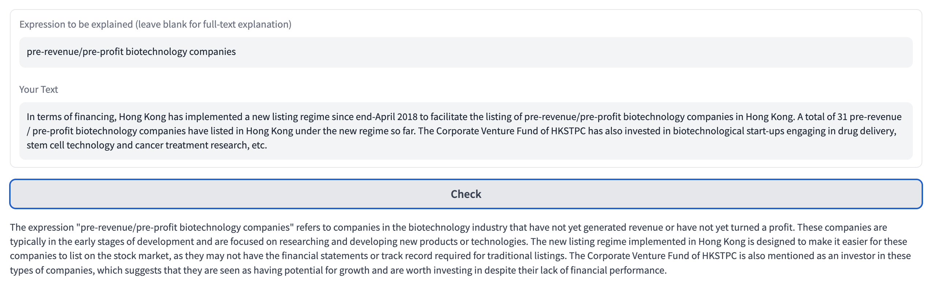
Input: In terms of financing, Hong Kong has implemented a new listing regime since end-April 2018 to facilitate the listing of pre-revenue/pre-profit biotechnology companies in Hong Kong. A total of 31 pre-revenue / pre-profit biotechnology companies have listed in Hong Kong under the new regime so far. The Corporate Venture Fund of HKSTPC has also invested in biotechnological start-ups engaging in drug delivery, stem cell technology and cancer treatment research, etc.
Explanation: The expression "pre-revenue/pre-profit biotechnology companies" refers to companies in the biotechnology industry that have not yet generated revenue or have not yet turned a profit. These companies are typically in the early stages of development and are focused on researching and developing new products or technologies. The new listing regime implemented in Hong Kong is designed to make it easier for these companies to list on the stock market, as they may not have the financial statements or track record required for traditional listings …

Slide 72
Example 3
Task: Explain a given sentence within the context of a paragraph.
Input:
"Hong Kong is a leading player in green finance. In 2022, green and sustainable debts arranged or issued in Hong Kong amounted to over US$80.5 billion," Mr Hui said, adding that the US$101 million tokenised green bond issued by the Hong Kong Special Administrative Region Government in February this year, the first of its kind released in the world by a government, could further entrench the awareness of sustainability issues in combination with technology.

Slide 73
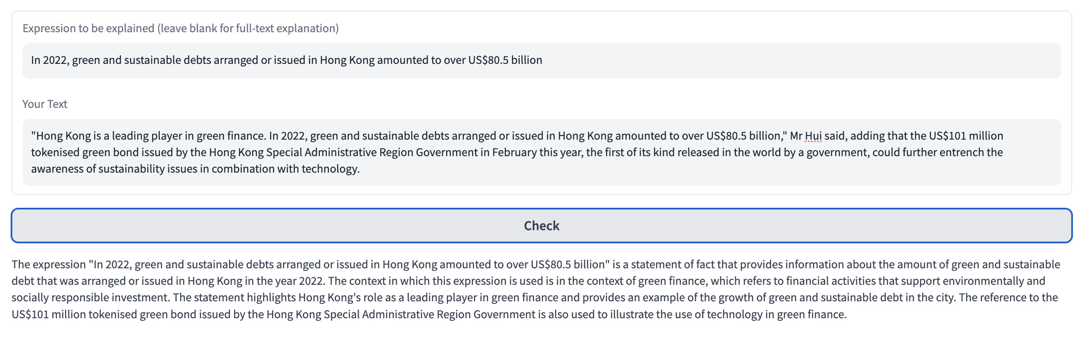
The context in which the given sentence is used.
Explanation of "green finance."
Connection of the given sentence with other parts of the text.

Slide 74
Platform 4: Sentence Finder
This tool assists translators in identifying previously translated or similar sentences or expressions for reference and reuse. This may help reduce the need for retranslating every aspect of the content.
It could also facilitate the alignment of terminology and translation style with those found in previously translated content.

Slide 75


Conventional form of TM
1. string similarity
New SL
sentence
Existing SL
sentence
Corresponding TL
sentence
2. Aligned bilingual sentences

Slide 76
Current Problems with TMs
Semantic vs. Syntactic Similarity
Conventional methods often depend on string similarity in terms of edit distance. However, syntactically similar sentences may not be semantically relevant.
Example: "The company's stock price rose" and "The company's stock price fell" are syntactically similar but semantically opposite.

Slide 77
Current Problems with TMs
On the other hand, semantically relevant expressions can be presented in different syntactic structures.
Example: "The company's stock price plummeted" and "The company experienced a significant drop in its stock price" convey similar meanings but are syntactically different.

Slide 78
Current Problems with TMs
Data Requirements and Limitations
Conventional methods typically demand bilingual aligned data and often struggle to efficiently retrieve or use monolingual data.
Monolingual data, which may be more readily available, offer examples originally written in the target language and serve as valuable reference points for translation.

Slide 79
Current Problems with TMs
Example: A monolingual financial report could provide idiomatic language and industry-specific terminology that are authentic to the target language, offering valuable reference points for translation.

Slide 80
Features
Calculation of embedding similarity
Cross-lingual retrieval of monolingual and bilingual content without the need for alignment

Slide 81
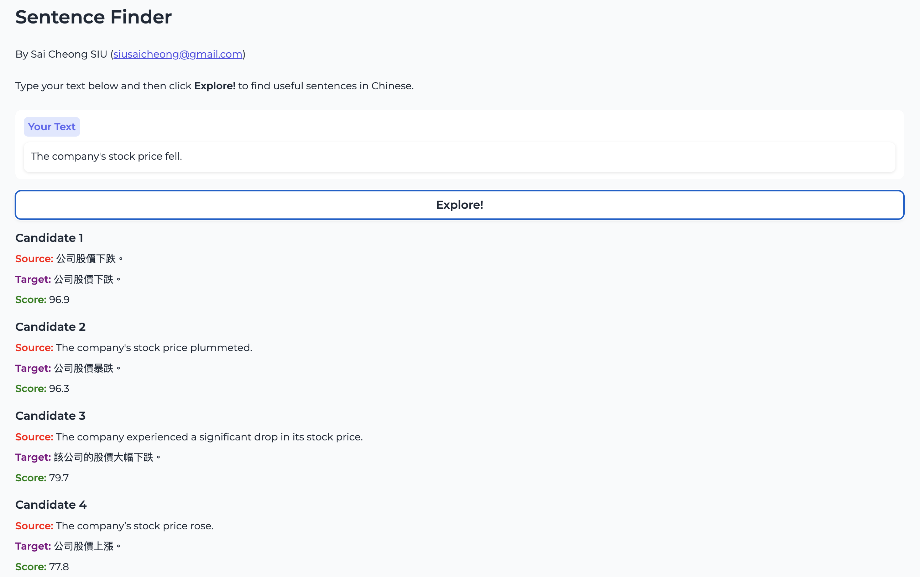

Slide 82



How does it work?
ST
Comparison
Ranking
List of useful sentences / expressions
Previous content
Embedding generation

Slide 83
Example
Input: The company's stock price fell.
Conventional method based on string similarity:
Candidate | Score
The company’s stock price rose.* | 83.9%
The company's stock price plummeted. * | 75.7%
The company experienced a significant drop in its stock price.* | 32.3%
*Note: The corresponding Chinese translation is omitted here.

Slide 84
Example
1. More reasonable scores!
Input: The company's stock price fell.
Our Output:
Candidate | Score
The company’s stock price rose.* | 77.8%
The company's stock price plummeted. * | 96.3%
The company experienced a significant drop in its stock price.* | 79.7%
公司股價下跌。 | 96.9%
Lower! TM: 83.9%
Higher! TM: 75.7%
Higher! TM: 32.3%
New! TM: N/A
*Note: The corresponding Chinese translation is omitted here.
2. Cross-lingual retrieval of content

Slide 85

4. The Way Forward

Slide 86











The Way Forward (see Siu 2023b)
Multilingual NMT
Multiple Models
Deeper Models
Multiple language pairs
More Layers
Document-level NMT
Domain Adaptation
Pre-trained language models (e.g., ChatGPT)
As sentences
Connection
1
2
3
1. Pre-training
3. Multiple Tasks!
2. Fine-tuning / Prompt engineering
As a document
Specialized translation models

Slide 87
Noteworthy trend
Large language models (LLMs)

Slide 88
NMT again
Encoder
ST
Example: I love translation.
Next TT word?
TT
Decoder
Example: 我

Slide 89
Example of LLM
More parameters
More training data
Next TT word?
Prompt + Input (ST)
Decoder
Example:
Translate the following into Chinese:
I love translation.

Slide 90
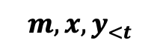
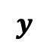
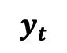

Decoder-based LLMs like ChatGPT
$$m,{x,y}_{<t}$$
$$φ$$
$$y_{t}$$
Prompt + Input
Decoder
Internal representation (TT)
Next token
$$y$$
Output

Slide 91
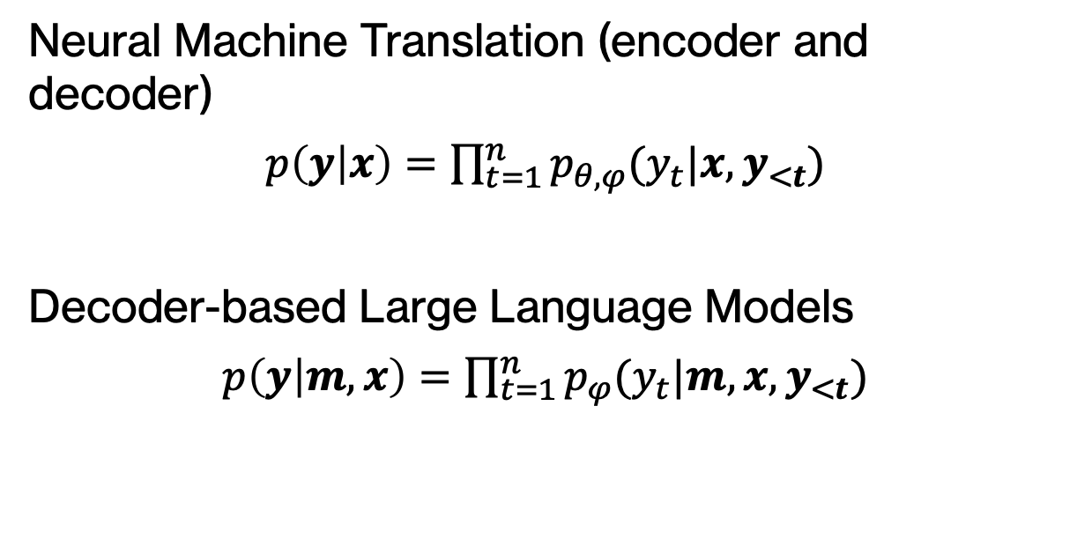
Formally, we have
Neural Machine Translation (encoder and decoder)
$p\left(y | x\right)=$ $\prod_{t=1}^{n}{p_{θ,φ}(y_{t}|x,y_{<t})}$
Decoder-based Large Language Models
$p\left(y | m,x\right)=$ $\prod_{t=1}^{n}{p_{φ}(y_{t}|m,{x,y}_{<t})}$

Slide 92
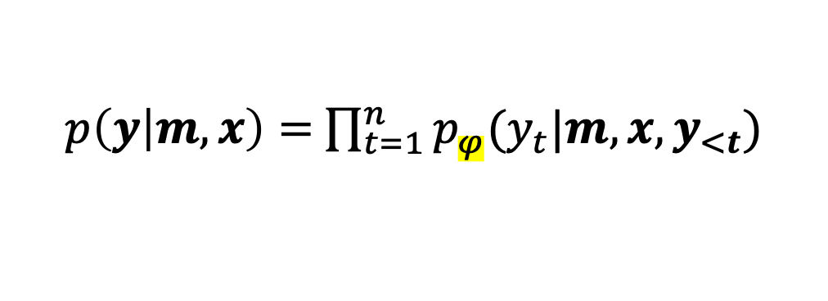
ChatGPT: An Example
$p\left(y | m,x\right)=$ $\prod_{t=1}^{n}{p_{φ}(y_{t}|m,{x,y}_{<t})}$
2018
GPT-1 (117 million)
2019
GPT-2 (1.5 billion)
2020
GPT-3 (175 billion)
2022
GPT-3.5 (ChatGPT)
2023
GPT-4 (Unknown)

Slide 93
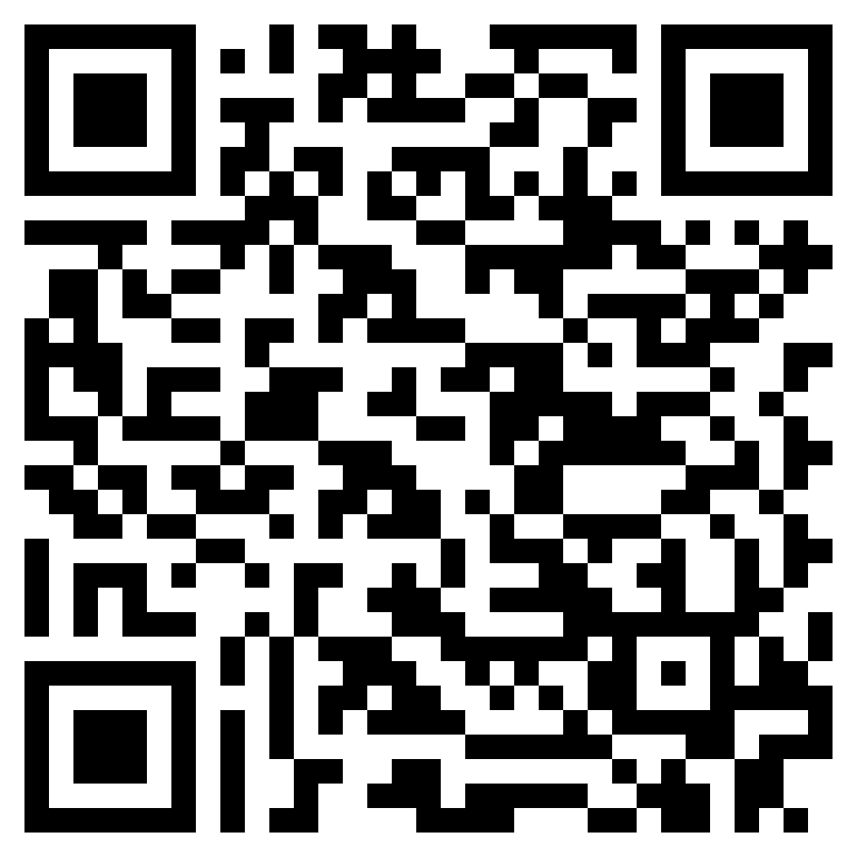
Read More
“ChatGPT and GPT-4 for Professional Translators: Exploring the Potential of Large Language Models in Translation” (Siu 2023a) [Link]
An Overview of ChatGPT and its Predecessors
ChatGPT as a Tool for Translators: Exploring Use Cases
Strengths and Limitations of ChatGPT in the Context of Translation
Impacts of ChatGPT on Translators and Language Professionals
The Future of ChatGPT as a Translation Tool

Slide 94
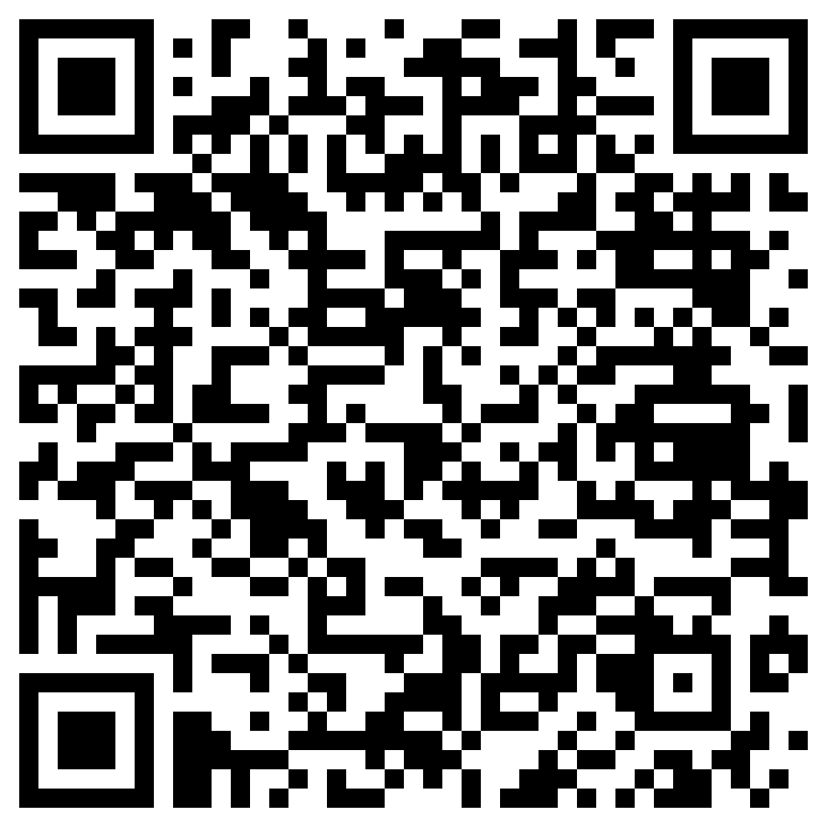
Read More
“Deep Learning and Translation Technology” - see Chapter 47, Routledge Encyclopedia of Translation Technology (2nd Edition) (Siu 2023b)
An Introduction to Deep Learning
Main Tasks of Deep Learning
An Overview of Neural Machine Translation
Recurrent Neural Networks for Translation
Convolutional Neural Networks for Translation
Self-attention Neural Networks for Translation
Deep Learning for Other Translation-related Applications
Other Noteworthy Trends

Slide 95

Read More
“Revolutionising Translation with AI: Unravelling Neural Machine Translation and Generative Pre-trained Large Language Models” (Siu 2023c) [Link]
An Overview of Deep Learning
The Transformer Model Explained
AI for Translation: NMT and Generative Pre-trained
Strengths and Limitations of NMT and LLMs
Recommendations for Translation Educators
Recommendations for Developers

Slide 96
Thank you!
scsiu@hsu.edu.hk
siusaicheong@gmail.com

